Slide 1
MADHAV SALES DATA ANALYSIS
Project: To Track and Analyze their Online Sales

Slide 2
Task Performed
Import Data
Transform the Data
Draw the Chart
Making the Interactive Dashboard

Slide 3
Basic Information
Types of Category
Clothing
Electronics
Furniture
Payment Mode
COD
Credit Card
Debit Card
EMI
UPI

Slide 4
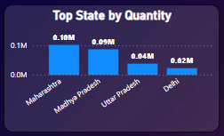
Top State PERFORMER
These are States Out Performed in context of Quantity
Company needs to increase the quantity of stock in these states
Company can also give special offer to customers of these states

Slide 5
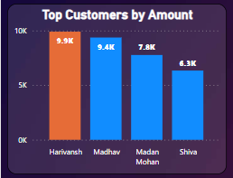
TOP CUSTOMERS
These are 4 Top Customers in context of Amount
Company can give extra offer to these customers

Slide 6
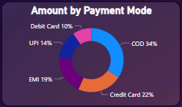
AMOUNT DISTRIBUTION BY PAYMENT METHOD
These are the Payment mode used by customers and COD mode is maximum time used
If company wants that customer use any other particular mode of payment then it can give extra offer to those who are going to use that mode of payment

Slide 7
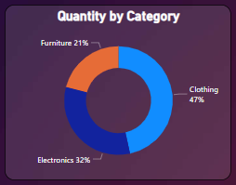
Quantity distribution by category wise
These are the Categories under which maximum quantity is clothing category
Company needs to give special attention to Furniture category because it contain lowest among all.

Slide 8
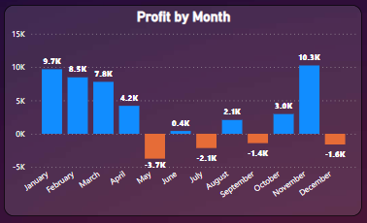
Profit BY MONTH
Company needs to look into the sales data of May, July, September and December and June also because among these countries profit is negative
Company needs to find reason of negative profit

Slide 9
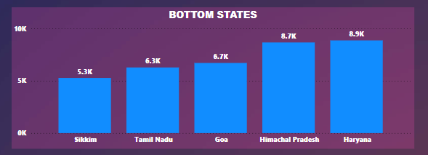
BOTTOM STATES
These are the states which lowest in terms of sales
Company needs to give special attention to these states and find out the reason why these states are not performing well if required give special offer only for these states

Slide 10
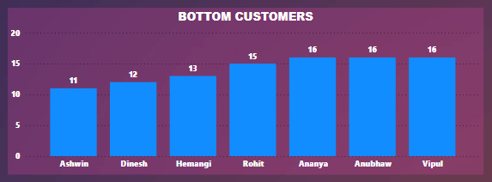
BOTTOM CUSTOMERS
These are the customers who have buy lowest among all the customers

Slide 11
Project Learning
Create interactive dashboard to track and analyze online sales data.
Customization by using Filters and Slicers
Create connection, join tables
Use different types of charts like Bar chart, Pie chart, Donut chart

Slide 12


